Slide 1


PREDICT NBA CHAMPIONSHIP
📝 ASDS 5302 – Final Project
The Classification Pack
👥 Members:
Phuong Trinh
Swathi Gutta
Prithwiraj Chatterjee
Pradhyumna Danduboina

Slide 2
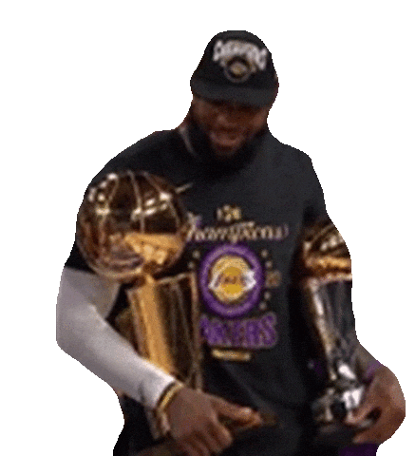
Abstract
🏀 Goal:
Predict the 2024–2025 NBA Champion
Forecast outcomes based on real-time and historical data.
♟️ Approach:
📥 Data Collection: Retrieve team, player and standing data using the NBA API.
🛠️ Modeling: Apply Logistic Regression, Random Forest, and XGBoost.
📊 Evaluation: Compare model metrics (Accuracy, Precision, F1, ROC).
🏆 Outcome: Identify top contenders with highest championship probability.

Slide 3

🔥 Why NBA Predictions?
🏀 Basketball is no longer just about intuition — it's about data.
📈 We analyze team stats, player performance, standings to predict the future.
🤖 Powered by Machine Learning, we aim to forecast the next NBA Championship!

Slide 4

What is the NBA API
API (Application Programming Interface): Allows two systems to communicate by sending/receiving data.
NBA-API: Official database providing real-time and historical NBA data
Formats: JSON ➔ parsed to structured tables (Pandas DataFrames)
Key Endpoints Used:
🔹 leagueStandings:
30 teams × 81 variables (wins, losses, situational splits, monthly performance).
🔹 leagueDashTeamStats:
30 teams × 54 stats ➔ narrowed to ~14 essential features (points, rebounds, etc.).
🔹 leagueDashPlayerStats:
572 players × 66 fields (per-game stats + advanced player metrics).

Slide 5

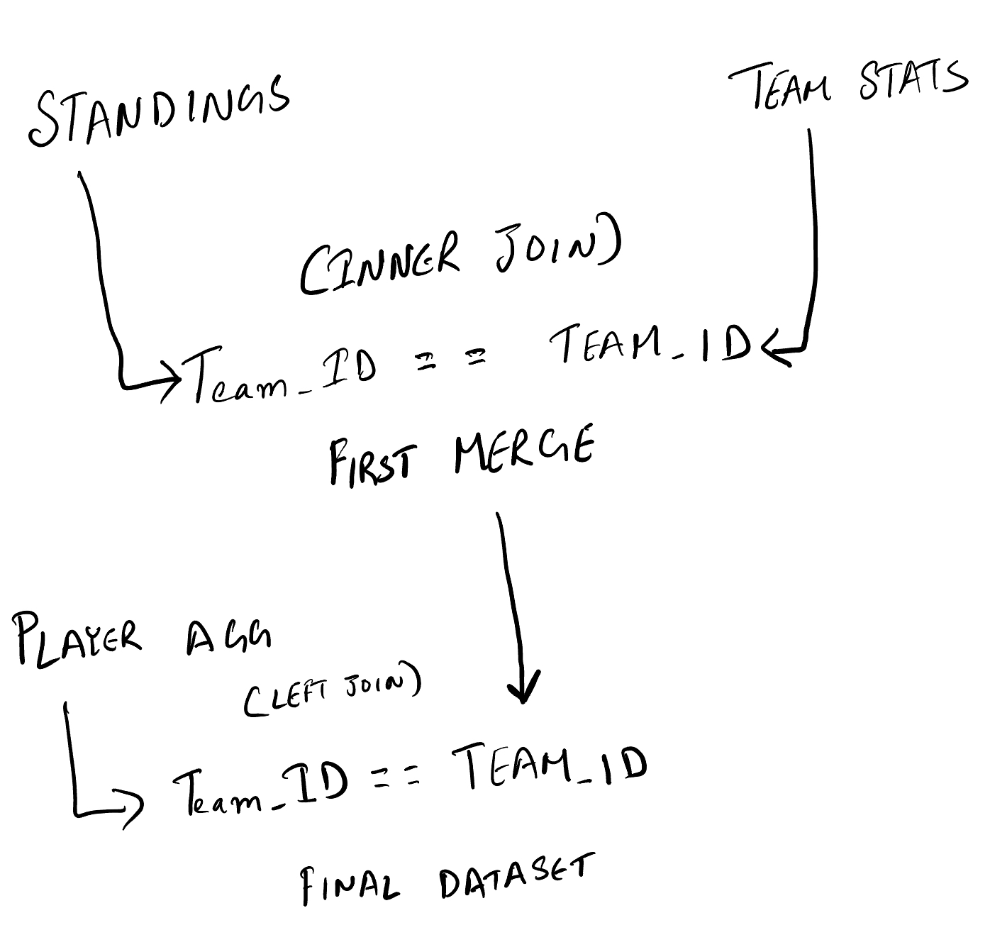
How We Create the Dataset
Connect to NBA API endpoints (requests + pandas)
1
Parse into DataFrames (standings, team stats, player stats)
2
Merge DataFrames on common keys (team_id, season)
3
Clean and engineer new features (Home Win Lose, Road Win Lose, Assist Ratio)
4

Slide 6
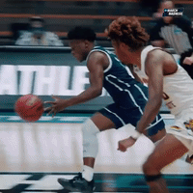
🏀 Data Overview
Features:
📊 Points, Assists, Rebounds, Steals, Blocks
🔄 Turnovers
🏆 Win %, Field Goal %
🏡 Win/Loss, Home/Away, Opponent Stats
🏅 Playoff rank
Data size:
📦 Depends on teams available in the NBA API.
Data shape:
Number of teams × Features.

Slide 7
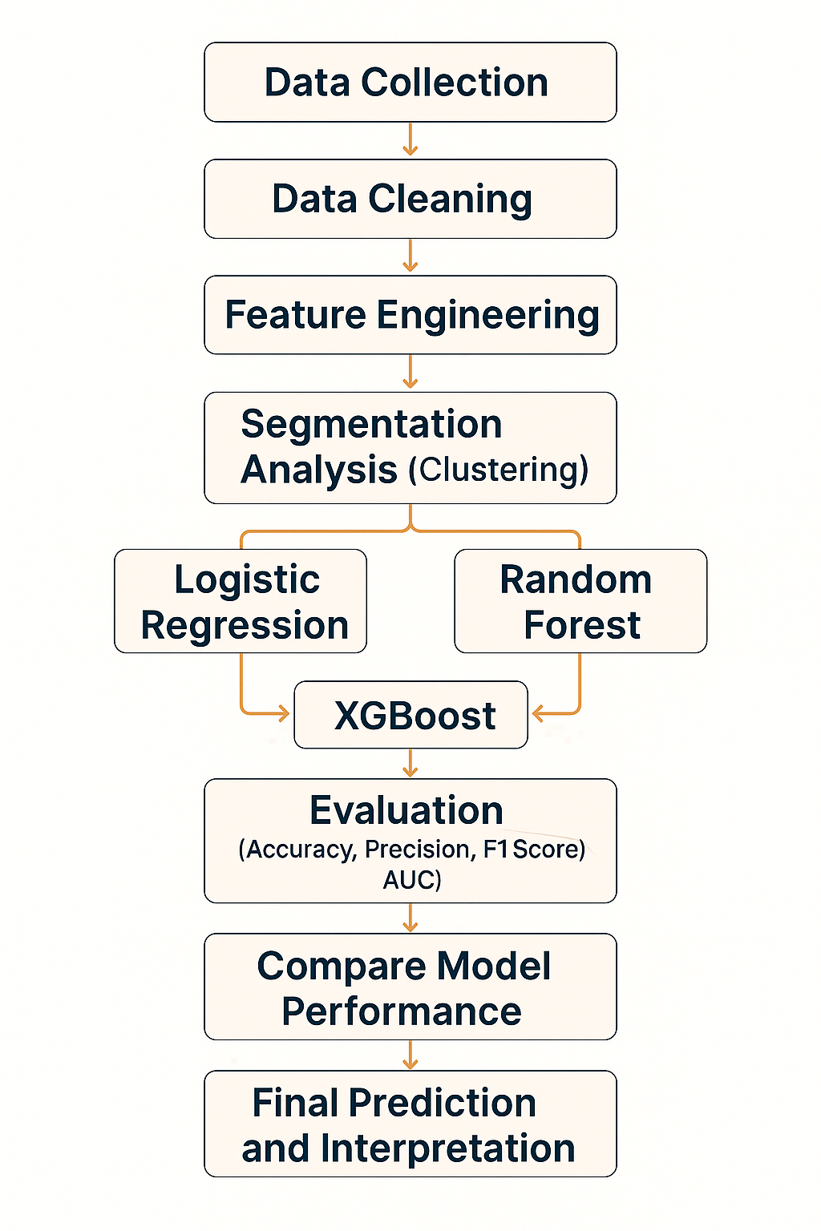

Workflow

Slide 8
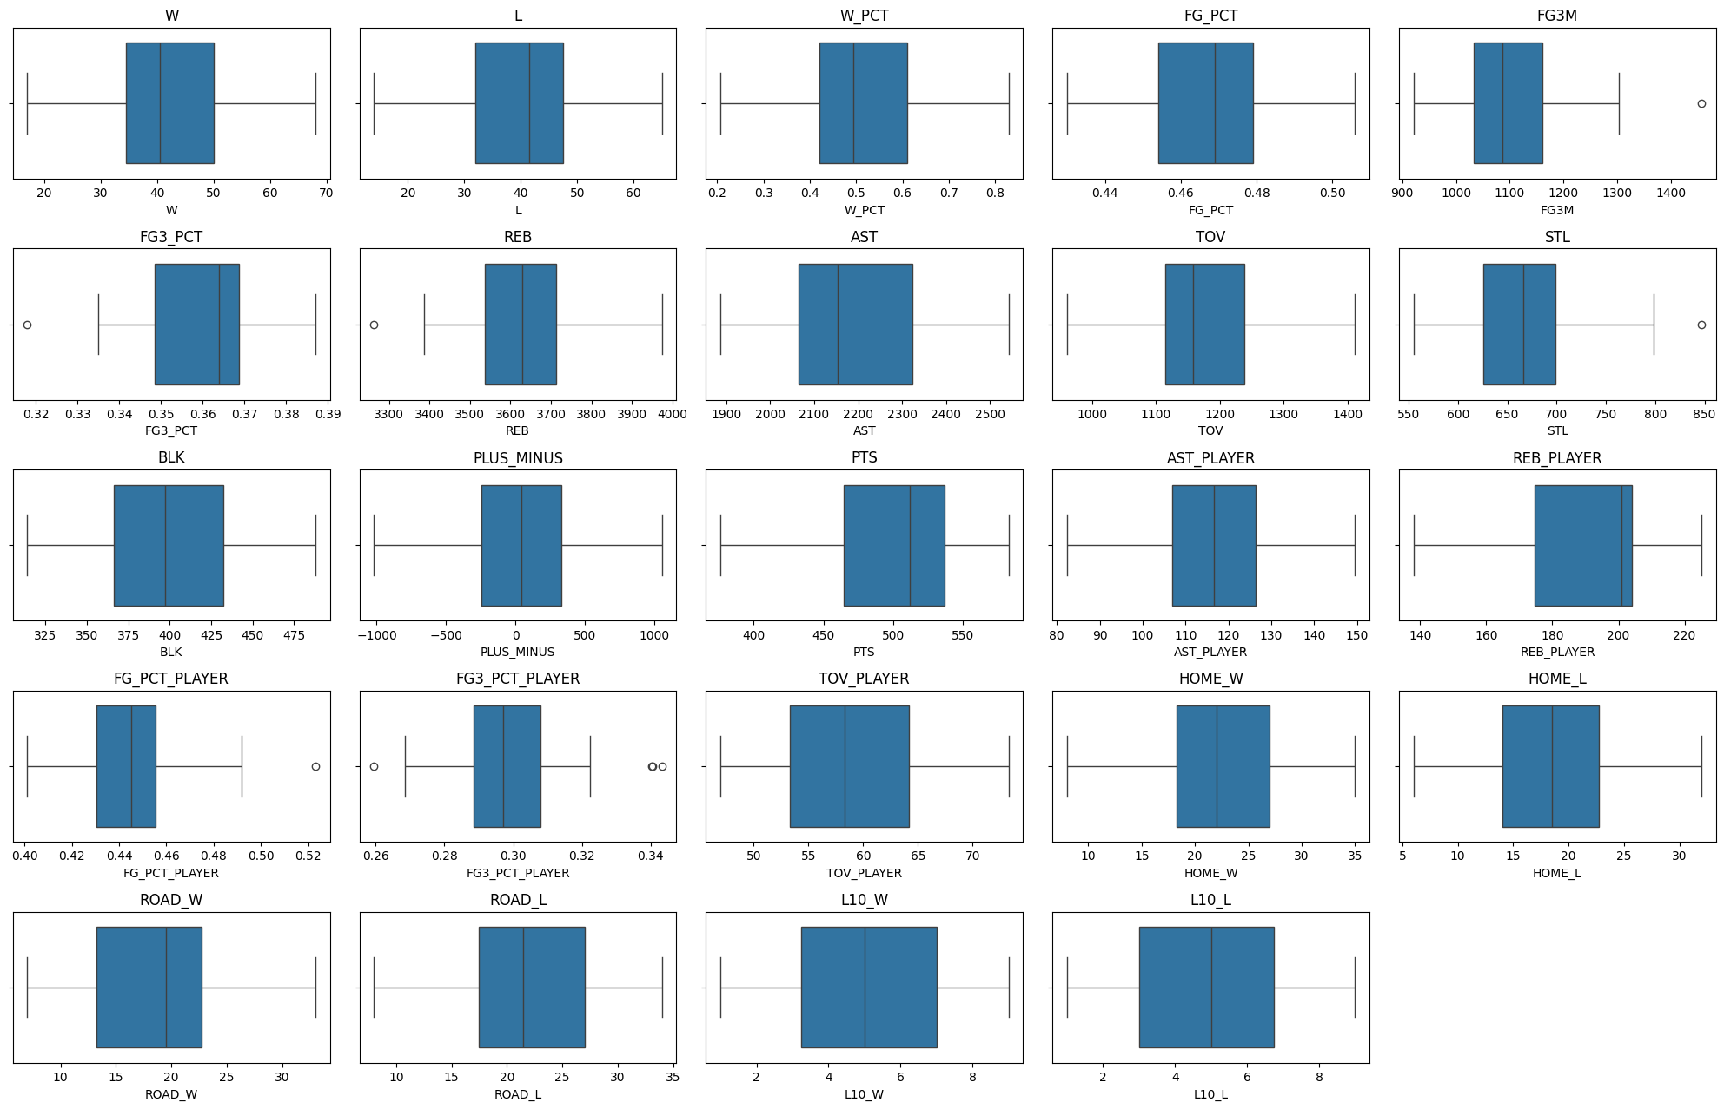

Data Cleaning & Scaling
Missing Values: None
Duplicates : None
Outliers: Few but not concerned
Apply Normalization Scaling to data

Slide 9

Exploratory Data Analysis
NBA EDA - Power BI

Slide 10

Feature Engineering
🧠 Assist Ratio:
Measures a player's or team's ability to generate assists without turning the ball over.
Indicates efficiency and smart decision-making.
High Assist Ratio = strong ball movement and fewer mistakes.
⚡ Win Streak:
A simple indicator of overall momentum or performance trends.
Teams with more recent wins (positive win streaks) usually have momentum heading into the playoffs.
Powerful trend beyond win percentage.

Slide 11

Team Clustering
Group NBA teams into similar performance categories using K-Means Clustering.
Method:
Features Used:
Points (PTS)
Win Percentage (W_PCT)
Assists Ratio
Turnovers (TOV)
Steals (STL), Blocks (BLK)
Plus/Minus (PLUS_MINUS)
Win Streak (WinStreak)
Scaling:
Features were standardized using StandardScaler to ensure fair clustering.
K-Means :
Use elbow method to choose k = 4
Playoff Group | Seed Range
🟢 Elite | 1–4
🟠 Playoff | 5–8
🟣 Borderline | 9–12
🔵 Low | 13–15

Slide 12
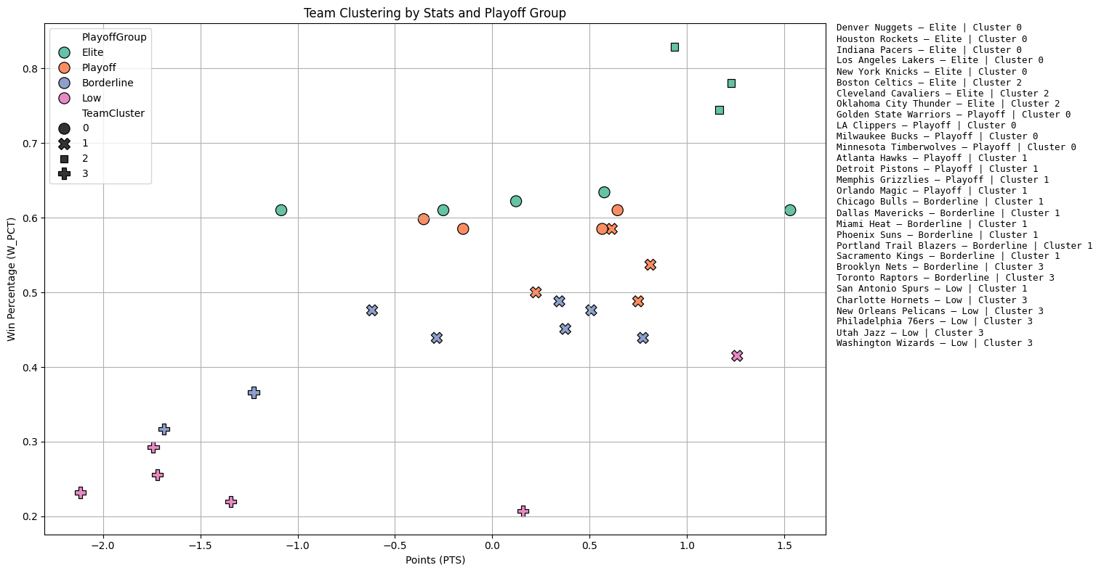

Clustering

Slide 13

Machine Learning Models
🏀 Training and Testing Setup
Test Size: 40% (Train 60% / Test 40%)
Stratify: Based on Playoff Class to keep class distribution balanced.
Features:
Points, Assists, Rebounds, Steals, Blocks, Turnovers, Win %, FG %, etc.
Target Variable:
Playoff Class (Elite, Playoff, Borderline, Low)
🚀 Models Used
🔹 Logistic Regression:
A simple linear baseline classifier.
🌲 Random Forest Classifier:
Handles non-linear patterns and interactions.
🚀 XGBoost Classifier:
Powerful boosting model, best for complex patterns and higher accuracy.

Slide 14

Performance Metrics
Model | Accuracy | Precision | F1 Score
🔹 Logistic Regression | 0.416667 | 0.458333 | 0.411111
🌲 Random Forest | 0.833333 | 0.900000 | 0.837500
🚀 XGBoost | 0.750000 | 0.837500 | 0.726786

Slide 15
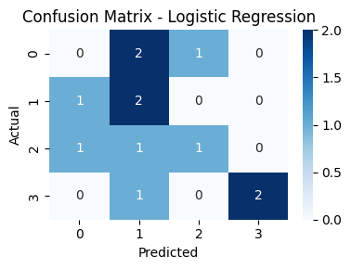
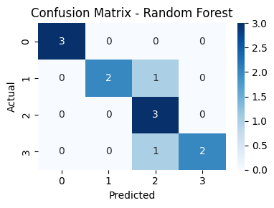
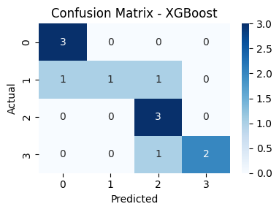

Confusion Matrices
🔹 4/12 correct
🌲 10/12 correct
🚀 9/12 correct

Slide 16

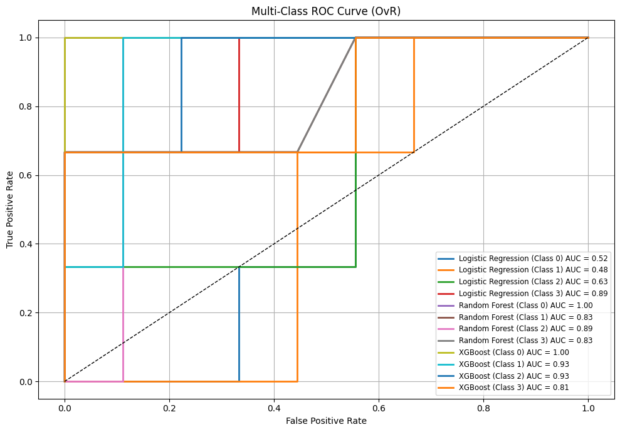
ROC Curve

Slide 17
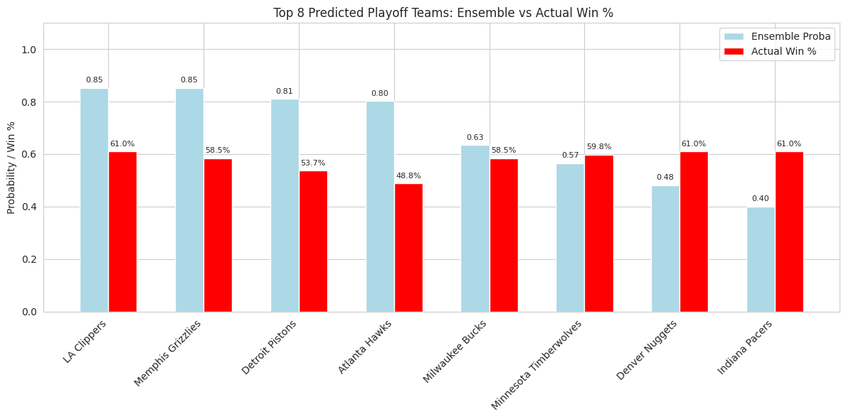
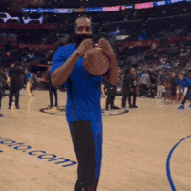


Final Prediction

Slide 18
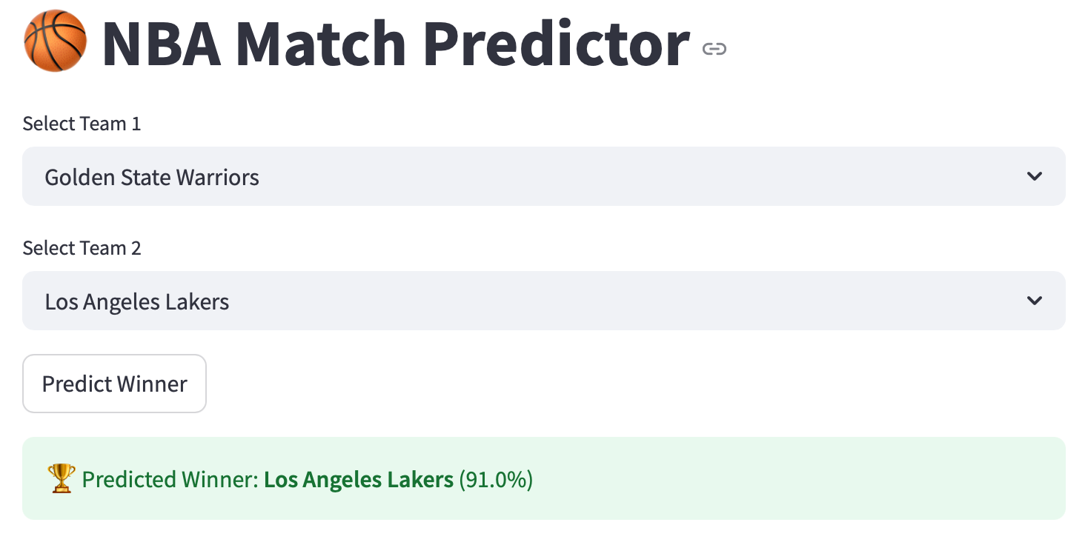
Team vs Team Matchup Prediction
Developed a Machine Learning model to predict the winning team based on team statistics.
🔹 Model Inputs:
Key features: Win Percentage, Points Scored, Rebounds, Assists, Field Goal %, Turnovers.
🔹 Web App Demonstration:
Select two teams from the dropdown
Instantly get prediction results.
View probability scores and key feature comparisons.
🔹 Final Prediction Outcome Example:
Predicted Winner: [Team A] over [Team B].
Winning Probability: 78% in favor of Team A.
🔹Predict your favorite team's next win with just one click!

Slide 19
Conclusions
✅ Random Forest and XGBoost models clearly outperform Logistic Regression. ➔ Higher predictive power, better handling of complex patterns.
✅ Tree-based models (Random Forest, XGBoost) achieve higher Accuracy and F1 scores, making them more reliable for championship prediction.
✅ Feature importance analysis identifies critical factors influencing success, such as: • Points Scored • Turnovers • Win Percentage • Rebounds and Assists
✅ Logistic Regression, being a linear model, struggles with the non-linear, multi-feature nature of NBA data.

Slide 20

Future Work
🔧 Hyperparameter Tuning & Cross-Validation: • Fine-tune model parameters to boost accuracy and avoid overfitting. • Ensure robustness through k-fold validation techniques.
🏀 Incorporate Advanced Player Metrics: • Add player synergy scores, injury status, and roster depth into the model for richer prediction insights.
📊 Develop Interactive Dashboard: • Build a live dashboard for real-time updates and playoff predictions. • Allow users to visualize standings, stats, and model forecasts dynamically.

Slide 21
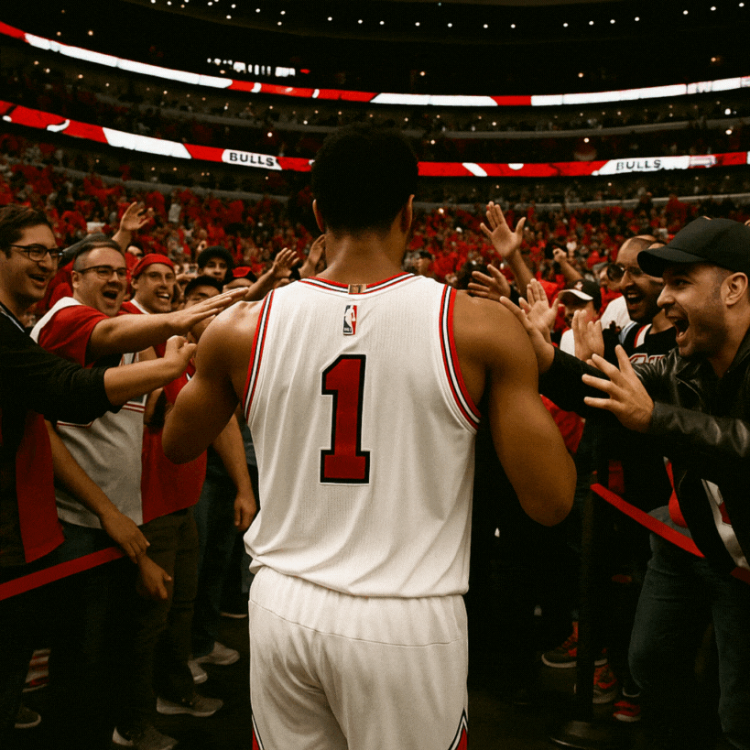

Q&A

